Slide 1
Gesture Recognition System
Zackary Dickens, Miles Mayhew

Slide 2
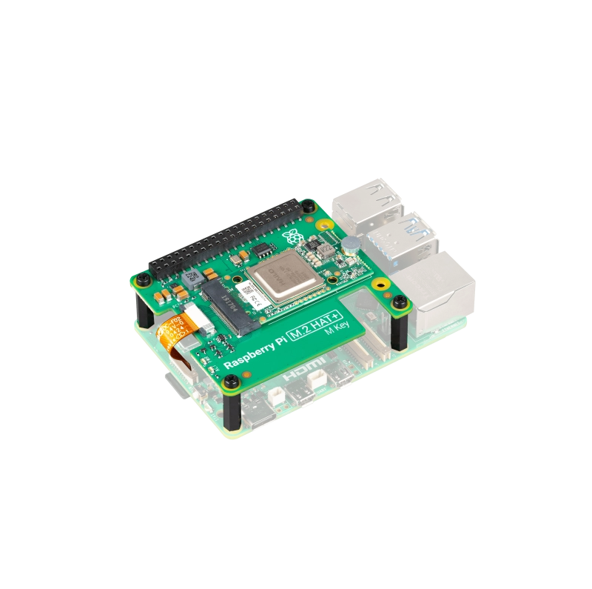

Project Idea
Use the Raspberry Pi AI Kit to identify gestures
  Open Palm
  Fist
  Point
  Thumbs Up
Gestures will be printed when detected and measured for response time
Could enable touch-free controlling for devices

Slide 3
Validation Metrics
Gestures should be classified correctly more than 90% of the time
Gestures should be detected and printed within 150 ms of being performed
Testing will occur in different lighting conditions and by different users

Slide 4
Milestones
Hardware Setup and Integration
Gesture Mapping and System Control
Model and Gesture Training
Testing and Presenting

Slide 5
The End

